Slide 1




KJSIT-IET INTECH 2K23 National Level Poster cum Project Competition
Academic Year 2022-23
<<Job Portal>>
Rishikesh Giridhar
Oam Bhanushali
Mihir Patel
(Second Year Engineering)

Slide 2
Outline of Presentation
Introduction
Summary / Finding of Literature Survey
System Design & Architecture
Proposed Methodology( Algorithm / Flowchart etc)
Video & Audio demonstration of Running Project(5Mins)
Results
Conclusion
References
KJSIT-IET INTECH 2K23 National Level Poster cum Project Competition

Slide 3
Introduction:
To create a web portal which allows employees/employers to find jobs/recruit
To make a software which is clutter free and only provides the relevant details
Easy to use and access
Doesn't require high technical knowledge to operate
KJSIT-IET INTECH 2K23 National Level Poster cum Project Competition

Slide 4
Summary / Finding of Literature Survey
https://palletsprojects.com/p/flask/ (for learning about flask)
https://flask.palletsprojects.com/en/2.2.x/quickstart/#html-escaping (to learn HTML and connect it with Python)
https://flask.palletsprojects.com/en/2.2.x/appcontext/#storing-data (to learn about connection with database)
KJSIT-IET INTECH 2K23 National Level Poster cum Project Competition

Slide 5
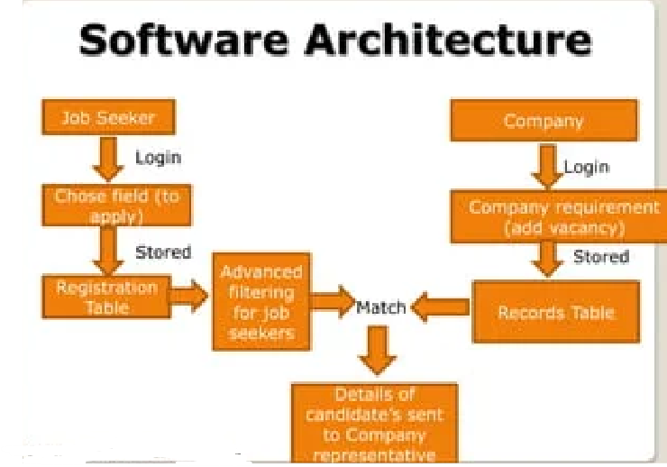
System Design & Architecture
FRONT-END WITH HTML AND CSS
USER-FRIENDLY INTERFACE FOR THE EMPLOYEE/COMPANY
SQLITE
KJSIT-IET INTECH 2K23 National Level Poster cum Project Competition

Slide 6
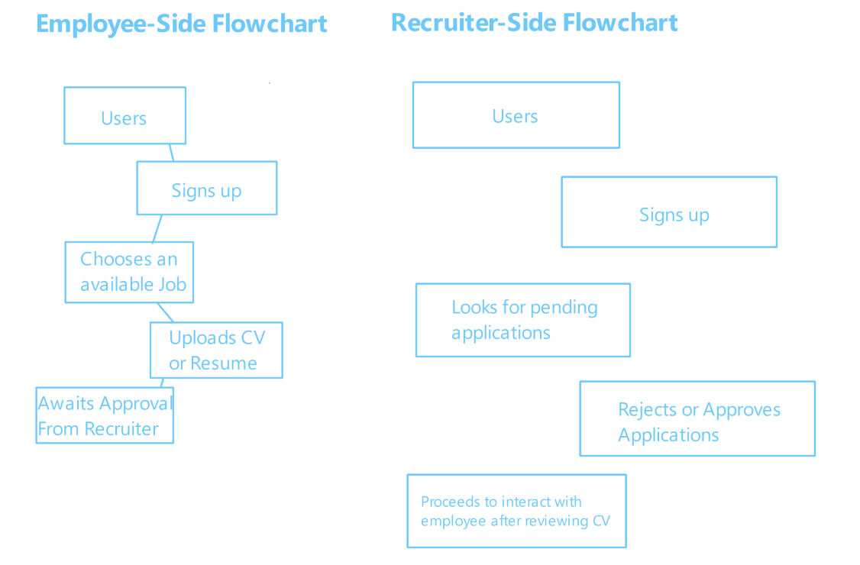
Proposed Methodology( Algorithm / Flowchart etc)
USERS
JOB-SEEKERS
RECRUITERS
Can Find a job and apply for it by uploading their CVs
Can post vacancies in job positions and can hire by assessing the applicant's CVs
KJSIT-IET INTECH 2K23 National Level Poster cum Project Competition

Slide 7
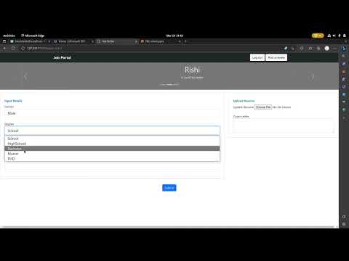
Video & Audio demonstration of Running Project
KJSIT-IET INTECH 2K23 National Level Poster cum Project Competition

Slide 8
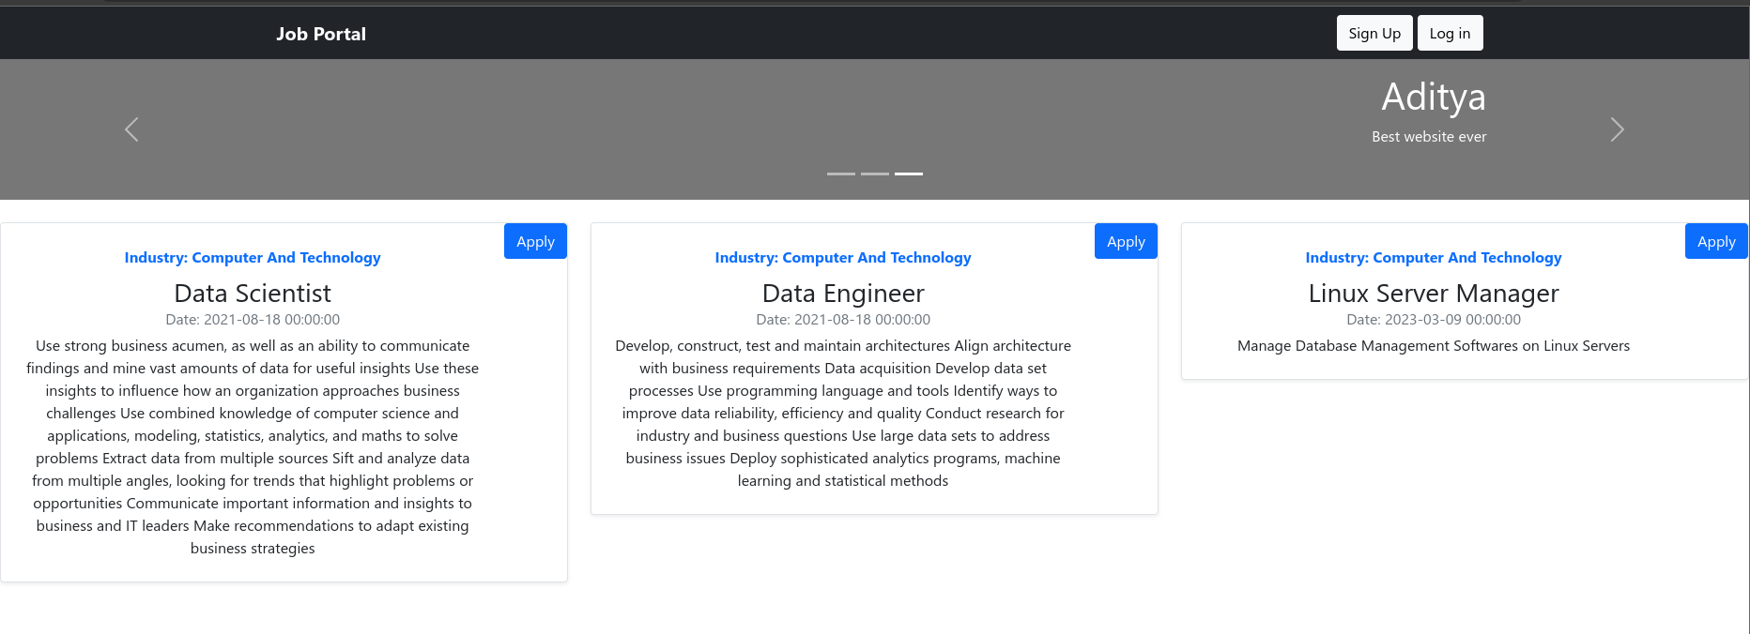
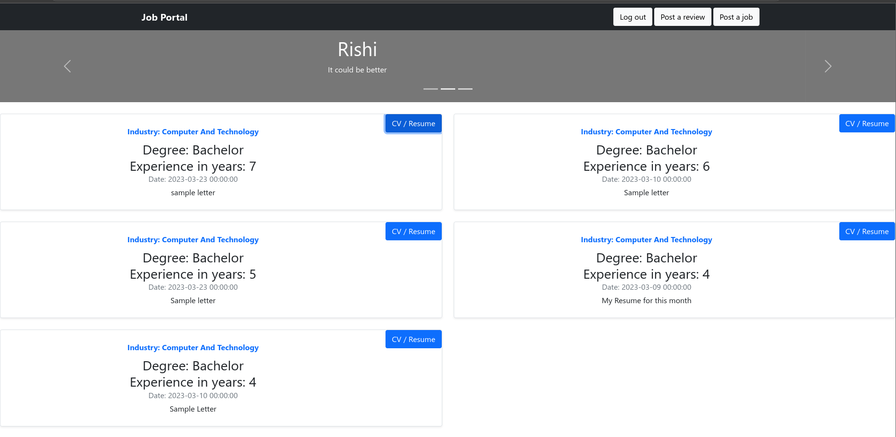
Results
KJSIT-IET INTECH 2K23 National Level Poster cum Project Competition

Slide 9
Conclusion
The job portal software promotes inclusivity and diversity in the workplace.
The software connects job seekers with relevant job opportunities, contributing to the growth of the economy.
The job portal software helps in reducing carbon emissions by eliminating the need for physical job advertisements and related paperwork.
The software serves as a valuable solution for both individuals and society as a whole.
The job portal software provides an accessible platform for people from all backgrounds and communities.
KJSIT-IET INTECH 2K23 National Level Poster cum Project Competition

Slide 10
References
Github.com
Geeksforgeeks.com
Python.org
KJSIT-IET INTECH 2K23 National Level Poster cum Project Competition

